Slide 1
Lockdown Learning through music-can with forget-me-not-productions
FUNTASTIC FRACTIONS

Slide 2
Resource Pack
ACTIVITY 1
listening
Activity 2
interpreting
Activity 3
Messy play
Activity 4
digital

Slide 3
BACKGROUND
MUSIC-CAN is a framework we have developed that uses music and the Arts as a motivate for individuals with complex disabilities to engage with assistive technology.
Music is an undeniable motivator – regardless of ability level or age range. We have therefore used the ethos of our MUSIC-CAN framework to develop Lockdown Learning through MUSIC-CAN with Forget-Me-Not-Productions.
These are FREE resources, released once a week (every Tuesday) to help parents/guardians and school pupils with home school learning.
First up in the series, released Tuesday 23rd June is FUNTASTIC FRACTIONS.

Slide 4
ACTIVITY 1
Listen to the song featured in the video below
(from 1 minute 10 seconds)
‘Funtastic Fractions’
Lyrics are overleaf

Slide 5
Funtastic Fractions
Funtastic fractions, they’re part of a whole
You can divide them into equal parts – big, medium, or small.
Should we cut 8 small pieces of apple pie? You must be having a laugh.
Let’s divide it in 2 down the middle, so my friend and I can eat both big halves (both big halves)
Funtastic fractions, they’re part of a whole
You divide them into equal parts – big, medium, or small.
You can cut that pie up into quarters – so 4 of us can eat it all.
But if you divide it into 16 slices – my stomach will growl ‘cos it’s much too small (much too small)
Funtastic fractions, they’re part of a whole
You can divide anything into equal parts – like a sweet, or a games console.
D is for the number that’s always DOWN – It’s the denominator.
And N is for the number that’s NEVER down – so that must be the numerator (numerator)
Funtastic fractions, they’re part of a whole
You divide them into equal parts – big, medium, or small.
I’m not a fan of sharing – so you can lick the bowl
And I’ll disappear in the other room and devour this apple pie whole (pie whole)
Funtastic fractions, they’re part of a whole.

Slide 6
Activity 2
What you think the song means? Explain this through one of the following:
Drawing
Painting
Clay model
Poster

Slide 7
Funtastic Fractions: DRAWING DESIGN

Slide 8
Funtastic Fractions: PAINTING DESIGN

Slide 9
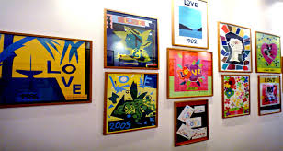
Funtastic Fractions: POSTER DESIGN

Slide 10
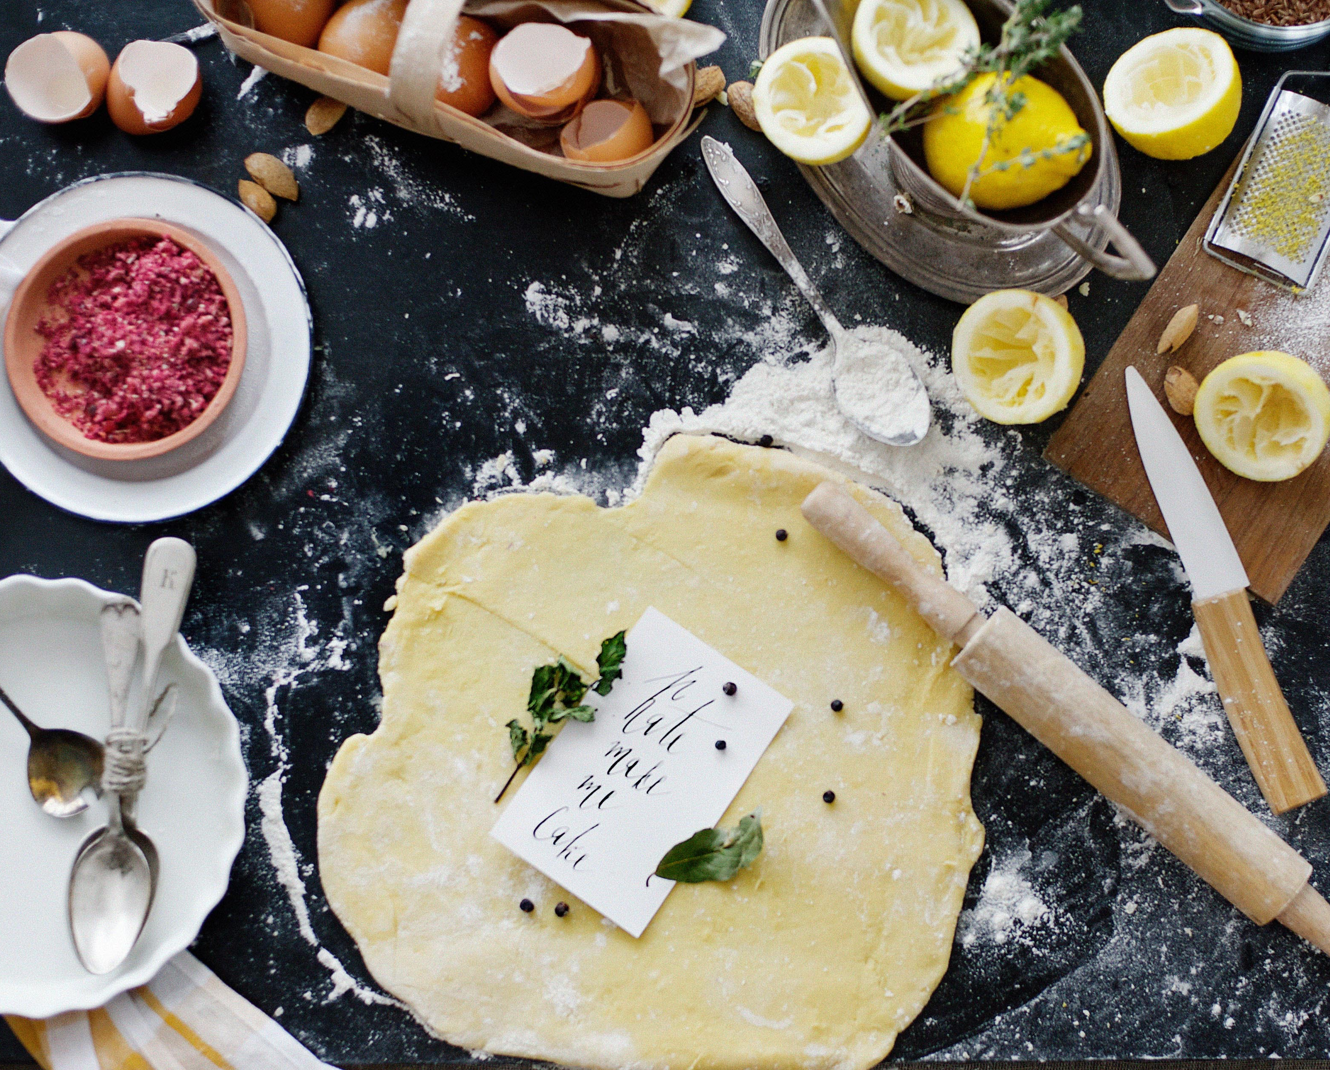
Activity 3
MESSY PLAY!
Cook an apple pie (or any other filling you’d prefer).
You must have adult supervision – use a pastry mix if easier.
How many people are having a slice of your pie? Write it down as a fraction please.

Slide 11
Activity 4
Make a music video to go with the song using a phone, iPad, tablet or camera. You can use moving or still images. Create a storyboard first to plan the music video (use template overleaf). Send the music video to: admin@forget-me-not-productions.co.uk when finished, or send them to us via facebook: https://www.facebook.com/FMNproductionsUK/

Slide 12
